Slide 1


Slide 2

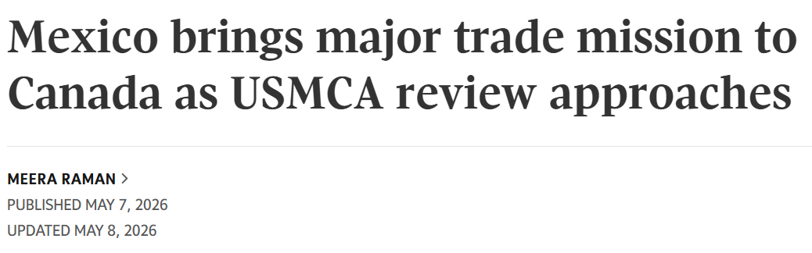
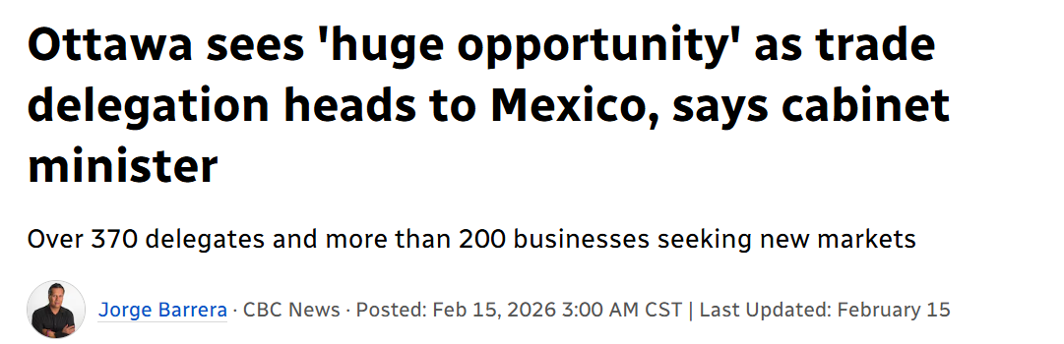

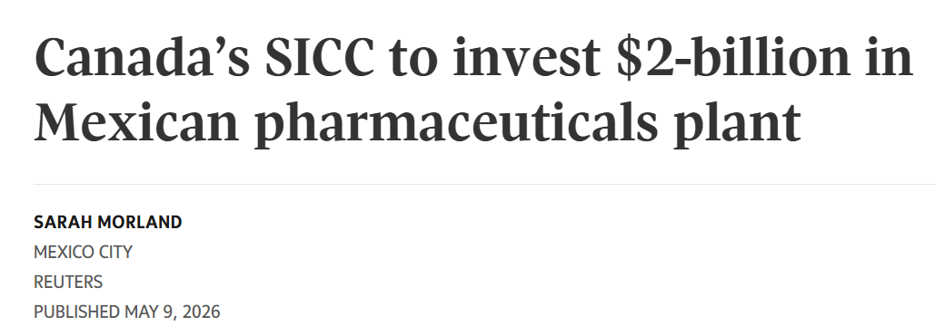
Mexico–Canada: Building the next chapter of North American Life Sciences
Plan México: Growth and prosperity
Main objectives
Move from the 12th to the 10th largest economy in the world
Raise the ratio of investment to GDP to over 25%
Generate 1.5 million jobs
Increase manufacturing in Mexico and ensure that 50% of domestic supply
Manufacture vaccines in the country using advanced biotechnology
Ensure that local governments buy at least 50% of their acquisitions from the domestic market
Mexico's Competitive Advantages:
Tax incentives for strategic investments Regulatory simplification and faster pathways through COFEPRIS
Access to one of the world's largest public healthcare procurement systems

Slide 3









Meet the Mexican Delegation at BIO 2026 # 4207
Representatives attending today's BIOTECanada Breakfast
Government of México
State Governments
Pharmaceutical Companies
Research & Innovation / Entrepreneurship

