Slide 1

A wealth of science
The partner of choice
Professor Chris Molloy
CEO, UK BioIndustry Association

Slide 2
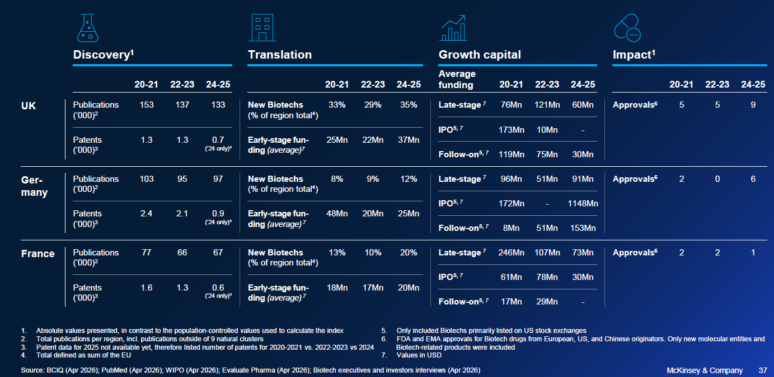
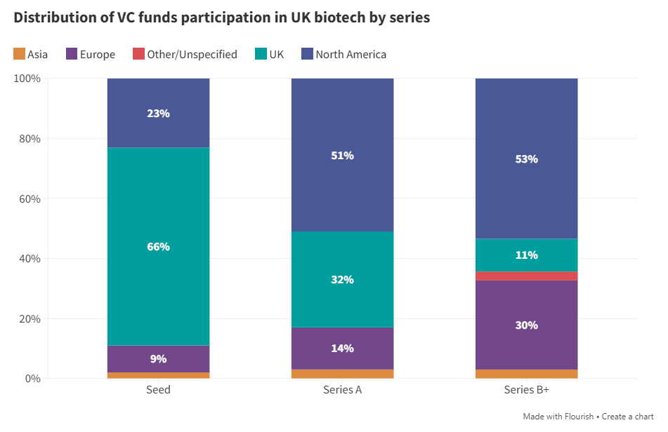
The biotech powerhouse of Europe
Productive
Globally Investable and Valuable

Slide 3



Partner of Choice in a Changed World
We're in a rupture, not a transition
If we are not at the table, we are on the menu
Shared
Cultures : Values : Science : Health Systems : Academic Collaboration : Access Consortium ; Strategy
Better together

Slide 4
A wealth of science
The partner of choice
Professor Chris Molloy
CEO, UK BioIndustry Association

